Slide 1
Conditions and Loops with Python
Week 3

Slide 2
Python Conditions and If statements
Python supports the usual logical conditions from mathematics:
Equals: a == b
Not Equals: a != b
Less than: a < b
Less than or equal to: a <= b
Greater than: a > b
Greater than or equal to: a >= b
These conditions can be used in several ways, most commonly in "if statements" and loops.
An "if statement" is written by using the if keyword.

Slide 3
If Else
In this example we use two variables, a and b, which are used as part of the if statement to test whether b is greater than (>) a.
a = 33
b = 200
if b > a:
print("b is greater than a")
Output: b is greater than a
This is because b > a = True
As a is 33, and b is 200, we know that 200 is greater than (>) 33, and so we print to screen that "b is greater than a".
If statement, without indentation will raise an error, IndentationError: expected an indented block

Slide 4
Elif
The elif keyword is pythons' way of saying "if the previous conditions were not true, then try this condition".
a = 33
b = 33
if b > a:
print("b is greater than a")
elif a == b:
print("a and b are equal")
In this example a is equal to b, so the first condition is not true, but the elif condition is TRUE, so we print to screen that "a and b are equal".

Slide 5
Else
The else keyword catches anything which isn't caught by the preceding conditions.
a = 200
b = 33
if b > a:
print("b is greater than a")
elif a == b:
print("a and b are equal")
else:
print("a is greater than b")
In this example a is greater than b, so the first condition is NOT TRUE, also the elif condition is NOT TRUE, so we go to the else condition and print to screen that "a is greater than b".
You can also have an else without the elif:

Slide 6
Short Hand If
if you have only one statement to execute, you can put it on the same line as the if statement.
if a > b: print("a is greater than b")

Slide 7
Short Hand If ... Else
If you have only one statement to execute, one for if, and one for else, you can put it all on the same line:
a = 2
b = 330
print("A") if a > b else print("B")
You can also have multiple else statements on the same line:
a = 330
b = 330
print("A") if a > b else print("=") if a == b else print("B")

Slide 8
And
The and keyword is a logical operator, and is used to combine conditional statements:
Test if a is greater than b, AND if c is greater than a:
a = 200
b = 33
c = 500
if a > b and c > a:
print("Both conditions are True")
Output: Both conditions are True

Slide 9
Or
The or keyword is a logical operator, and is used to combine conditional statements:
Test if a is greater than b, OR if a is greater than c:
a = 200
b = 33
c = 500
if a > b or a > c:
print("At least one of the conditions is True")
Output: At least one of the conditions is True

Slide 10
Nested If
You can have if statements inside if statements, this is called nested if statements.
x = 41
if x > 10:
print("Above ten,")
if x > 20:
print("and also above 20!")
else:
print("but not above 20.")

Slide 11
The pass Statement
if statements cannot be empty, but if you for some reason have an if statement with no content, put in the pass statement to avoid getting an error.
a = 33
b = 200
if b > a:
pass

Slide 12
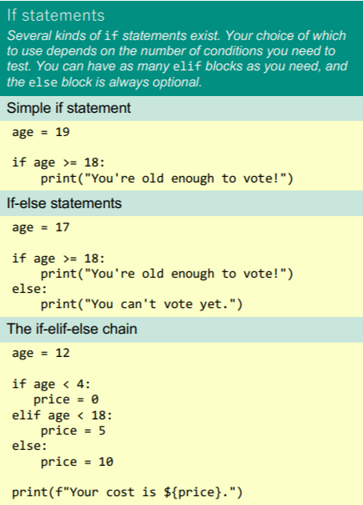
Python If statement snippets

Slide 13
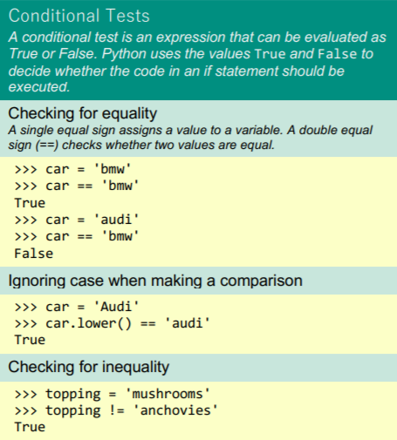
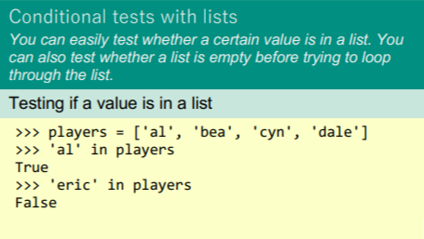
Python Condition Snippets

Slide 14
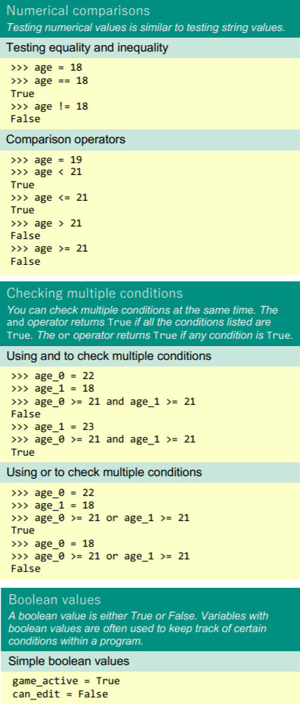
More snippets

Slide 15
Loops

Slide 16
While Loops

Slide 17
While Loops
With the while loop we can execute a set of statements as long as a condition is true.
Print i as long as i is less than 6:
i = 1
while i < 6:
print(i)
i += 1
Note: remember to increment i, or else the loop will continue forever.
The while loop requires relevant variables to be ready, in this example we need to define an indexing variable, i, which we set to 1.

Slide 18
The break Statement
With the break statement we can stop the loop even if the while condition is true:
Exit the loop when i is 3:
i = 1
while i < 6:
print(i)
if i == 3:
break
i += 1

Slide 19
The continue Statement
With the continue statement we can stop the current iteration, and continue with the next:
Continue to the next iteration if i is 3:
i = 0
while i < 6:
i += 1
if i == 3:
continue
print(i)

Slide 20
The else Statement
With the else statement we can run a block of code once when the condition no longer is true:
Print a message once the condition is false:
i = 1
while i < 6:
print(i)
i += 1
else:
print("i is no longer less than 6")

Slide 21
For Loops

Slide 22
Iterables
An object which can be looped over or iterated over with the help of a for loop.
Familiar examples of iterables include lists, tuples, and strings - any such sequence data types can be iterated over in a for-loop.
Such include a string.

Slide 23
Python For Loops
Use for iterating over a sequence (that is either a list, a tuple, a dictionary, a set, or a string).
Less like the for keyword in other programming languages and works more like an iterator method as found in other object-orientated programming languages.
it can execute a set of statements, once for each item in a list, tuple, set etc.
fruits = ["apple", "banana", "cherry"]
for x in fruits:
print(x)
Output:
apple
banana
cherry
The for loop does not require an indexing variable to set beforehand.

Slide 24
Looping Through a String
Even strings are iterable objects, they contain a sequence of characters:
for x in "banana":
print(x)
Output:
b
a
n
a
n
a

Slide 25
The break Statement
With the break statement we can stop the loop before it has looped through all the items:
Exit the loop when x is "banana":
fruits = ["apple", "banana", "cherry"]
for x in fruits:
print(x)
if x == "banana":
break
Output:

Slide 26
The break Statement
Exit the loop when x is "banana", but this time the break comes before the print:
fruits = ["apple", "banana", "cherry"]
for x in fruits:
if x == "banana":
break
print(x)
Output:

Slide 27
The continue Statement
With the continue statement we can stop the current iteration of the loop, and continue with the next:
Do not print banana:
fruits = ["apple", "banana", "cherry"]
for x in fruits:
if x == "banana":
continue
print(x)
Output:

Slide 28
The range() Function
To loop through a set of code a specified number of times, we can use the range() function,
The range() function returns a sequence of numbers, starting from 0 by default, and increments by 1 (by default), and ends at a specified number.
Using the range() function:
for x in range(6):
print(x)

Slide 29
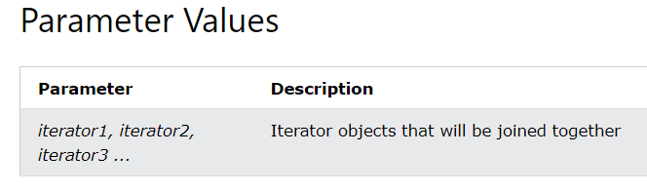
Python Zip
The zip() function returns a zip object, which is an iterator of tuples where the first item in each passed iterator is paired together, and then the second item in each passed iterator are paired together etc.
If the passed iterators have different lengths, the iterator with the least items decides the length of the new iterator.
zip(iterator1, iterator2, iterator3 ...)

Slide 30
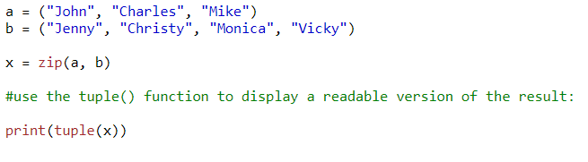
Zip Example

Slide 31
Python Enumerate
The enumerate() function takes a collection (e.g. a tuple) and returns it as an enumerate object.
The enumerate() function adds a counter as the key of the enumerate object.
enumerate(iterable, start)
start : Defines the start number of the enumerate object. Default 0
Iterable: An Iterable Object

Slide 32
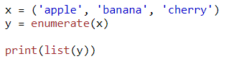
Enumerate Example

